Slide 1
Hotel Booking Customer Retention & Dynamic Pricing Analysis
Final Project Review
Presented By:
Ishwarya
B.Sc. Information Technology
Data Analytics Intern – Infotact

Slide 2
Project Overview
Business Problem
Hotels face significant challenges due to booking cancellations, fluctuating room prices, and changing customer booking behavior, which directly impact revenue and occupancy.
Project Objective
Analyze hotel booking trends
Identify cancellation patterns
Study customer behavior
Predict booking cancellations
Build an interactive Power BI dashboard for business decision-making

Slide 3
Predictive Modeling
Booking Cancellation Prediction
Problem Type
Binary Classification
Target Variable
is_canceled
Target Variable (Y)
is_canceled
0 → Booking Not Cancelled
1 → Booking Cancelled
Algorithm Used
Logistic Regression
Why Logistic Regression?
Simple and interpretable
Suitable for binary outcomes
Efficient baseline classification model

Slide 4
Model Evaluation
Model Performance
Evaluation Metrics
Feature Matrix and Target Variable
One-Hot Encoding
Train-Test Split
Logistic Regression Model
Accuracy
Precision
Recall
F1 Score
Confusion Matrix
ROC Curve & AUC Score
Business Benefit
The model helps hotels identify bookings with a higher probability of cancellation, enabling proactive decision-making.

Slide 5
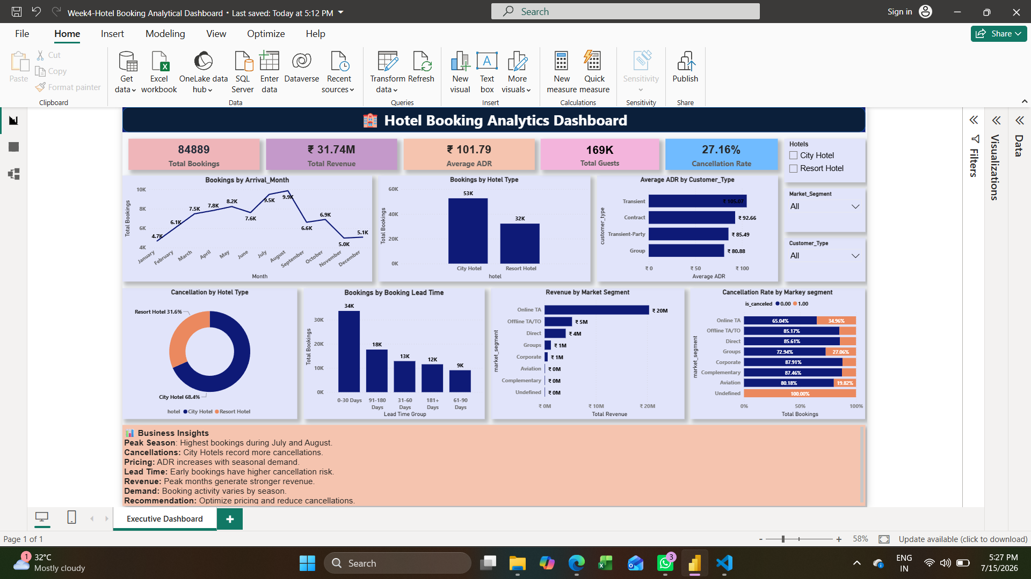
Power BI Dashboard
Executive Dashboard
Dashboard Features
Executive KPI Cards
Interactive Filters
Business Visualizations
Revenue Analysis
Cancellation Analysis
Customer Insights

Slide 6
Executive KPIs
Executive KPI Dashboard
The dashboard includes the following KPIs:
Total Bookings
Total Revenue
Average Daily Rate (ADR)
Total Guests
Cancellation Rate
These KPIs provide a quick overview of hotel business performance.

Slide 7
Dashboard Visualizations
Interactive Dashboard Analysis
Dashboard Includes
Monthly Booking Trend
Booking Distribution by Hotel Type
Average ADR by Customer Type
Revenue Contribution by Market Segment
Booking Distribution by Lead Time
Cancellation Distribution by Hotel Type
Cancellation Rate by Market Segment
Interactive slicers allow dynamic filtering by:
Hotel Type
Customer Type
Market Segment

Slide 8
Key Business Insights
Business Insights
City Hotels receive higher booking volumes than Resort Hotels.
Online Travel Agencies contribute significantly to hotel revenue.
Lead Time influences customer booking behavior.
Customer types show different ADR patterns.
Cancellation rates vary across market segments.

Slide 9
Business Recommendations
Recommendations
Improve customer retention through loyalty programs.
Optimize pricing strategies using ADR analysis.
Reduce cancellations with better booking policies.
Focus marketing efforts on high-value market segments.
Use booking trends for demand forecasting and resource planning.

Slide 10


